Slide 1


MSDS 403: Final Roadmap Project
Winter 2020
Sitara Abraham, Rakshit Bhatt, Isabella Valdescruz, Andrew Bernier

Slide 2
Introduction
Discussion Areas:
Use Case Rankings
Business Value for Top 3 Use Cases
Summary of All Use Cases
Architecture Diagrams
Digital Transformation Roadmap
Proposed Solution
Next Steps and Future Vision

Slide 3

Summary of all Use Cases
Customer Loyalty Program
New Store Location
Targeted Marketing
Fraud Detection
Customer Lifetime Value prediction
Customer Segmentation
Social Shopping
Sentiment Analysis
Augmented Reality
Digital/Physical Customer Experience

Slide 4
Final Use Case Rankings
Use Case | Stakeholder Impact | Data Accessibility/Viability | Enterprise Architecture Implementation
Customer Loyalty Program | 3.88 | 4.13 | 3.6
New Store Location | 3.38 | 2.87 | 2
Targeted Marketing | 3.75 | 3.6 | 3.6
Fraud Detection | 3.5 | 2.87 | 4
Customer Lifetime Value Prediction | 3.37 | 3.6 | 3.2
Customer Segmentation | 3.25 | 3.25 | 3.6
Social Shopping | 3.5 | 3.25 | 2.2
Sentiment Analysis | 2.9 | 2.9 | 2.2
Augmented Reality | 3.37 | 3 | 1.4
Digital / Physical Customer Experience | 3.38 | 2.25 | 2.4

Slide 5
Final Use Case Rankings (Cont.)
Use Case | Data Governance and Compliance | Measurement | Data Analysis and Modeling
Customer Loyalty Program | 2 | 4 | 5
New Store Location | 3 | 3.5 | 5
Targeted Marketing | 4 | 2 | 2.5
Fraud Detection | 2 | 4 | 3
Customer Lifetime Value Prediction | 2 | 2 | 4
Customer Segmentation | 3 | 2 | 2
Social Shopping | 1 | 4 | 3
Sentiment Analysis | 2 | 2.5 | 2
Augmented Reality | 2 | 2 | 2
Digital / Physical Customer Experience | 1 | 2 | 2

Slide 6
Final Use Case Rankings (Cont.)
Use Case | Average
Customer Loyalty Program | 3.76
2. New Store Location | 3.29
3. Targeted Marketing | 3.24
Fraud Detection | 3.22
Customer Lifetime Value Prediction | 3.02
Customer Segmentation | 2.85
Social Shopping | 2.82
Sentiment Analysis | 2.42
Augmented Reality | 2.29
Digital / Physical Customer Experience | 2.17

Slide 7
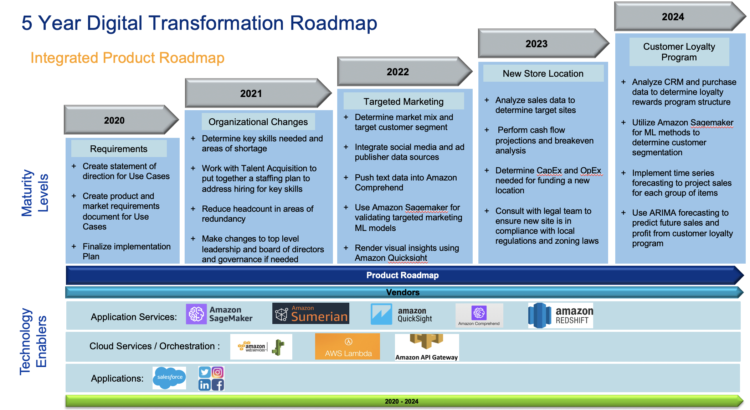
Digital Transformation Roadmap

Slide 8
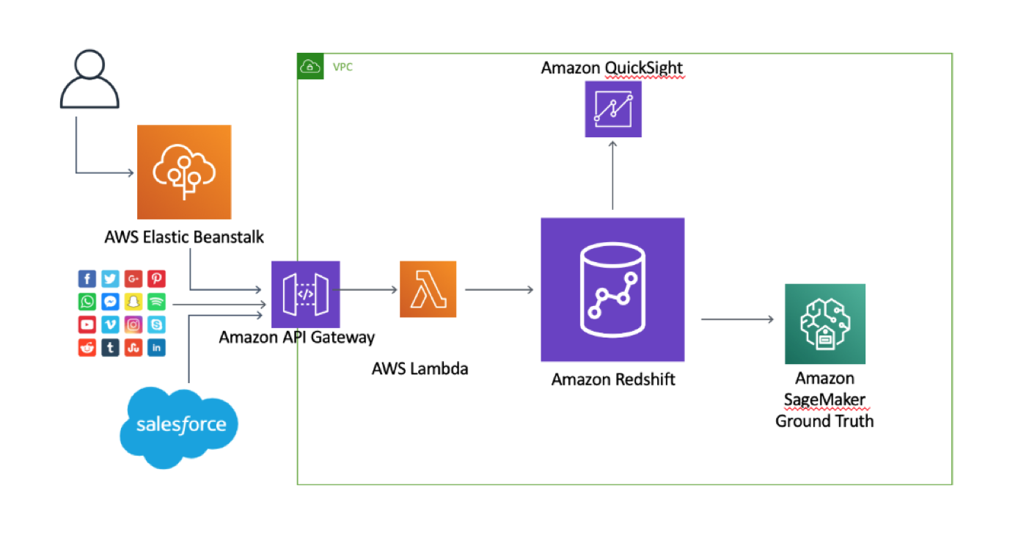
Architecture Diagram

Slide 9
Business Value for Targeted Marketing
Data
Modeling possibilities include A/B testing, recommendation systems, regression models for dynamic pricing
Highly Ranked
Data procurement
Governance/Compliance
Visualization
Impact derived from ad and website driven sales

Slide 10
Business Value for New Store Location
Data
Online sales location analysis - aka “Where are we shipping?”, competitor simulations, cost-benefit modeling
Highly Ranked
Data Analysis and Modeling
Measurement
Stakeholder Impact
Increases revenue, expands market, and achieves one of the Boards top priorities over the next five years

Slide 11
Business Value for Customer Loyalty Program
Data
Unifying customer and purchase data
Generates valuable customer data
Highly Ranked
Analytics and Modeling
Data Accessibility
Measurement
Increases revenue and customer retention

Slide 12
Next Steps and Future Vision
Important to remain flexible and react quickly to changing business landscape
Build on previous successes
Fraud Detection
Customer Lifetime Value Prediction
Customer Segmentation

